Slide 1
E-commerce Backend

Slide 2
1. Approach the Requirement
Step-by-step Development Process:
Domain Modelling: Define core entities (Product, Category,…) with relationships
API Design: RESTful endpoints following HTTP conventions
Service Layer: Business logic encapsulation and data transformation
Data Access: EF Core context with query optimization
Validation: FluentValidation for input/output validation
Performance: Caching layer and database query optimization
Infrastructure: Dependency injection and middleware configuration

Slide 3
1. Approach the Requirement
Key Principles Implemented
SOLID Principles
DRY (Don't Repeat Yourself): Shared DTOs, validators, and filters
Dependency Injection: Constructor-based DI for loose coupling
Async/Await: Non-blocking I/O operations throughout

Slide 4
2. Database Design
Database Choice: PostgreSQL (Production) + In-Memory (Demonstration)
Rationale for PostgreSQL:
Data Integrity: ACID compliance ensures reliable transactions
Scalability: Handles large datasets efficiently with proper indexing
Relationships: Excellent support for complex object-relational structures
Open Source: Cost-effective with strong community support
Performance: Native JSON support, advanced query optimization
Production-Ready: Battle-tested in enterprise environments

Slide 5
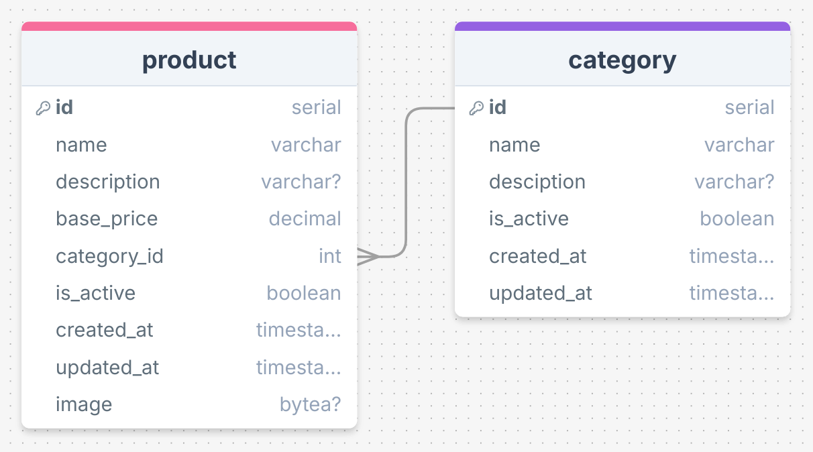
2. Database Design
Database Schema

Slide 6
2. Database Design
Design Features Supporting Extensibility:
Global Query Filters: Active record pattern
Soft Delete Support: is_active field allows logical deletion without data loss
Audit Trail: created_at and updated_at timestamps track changes
Extensible Entity Structure: Product entity architecture ready for (commented out for simplicity):
    ProductAttributes: Additional product features
    ProductVariants: Size, color, stock level variants

Slide 7
3. Technology Stack Components
Core Framework: .NET 8.0 - Modern language features and improved performance
Data Access & ORM:
  EntityFramework Core 9.0.11: ORM for database access
  Npgsql EF Core 9.0.4: PostgreSQL provider for EF Core
  EF Core InMemory 9.0.11: Development/testing database
Validation Framework: FluentValidation 12.1.0
Caching Strategy: StackExchange.Redis 2.10.1
API Documentation: Swashbuckle.AspNetCore 6.6.2

Slide 8
4. API and Data Handling
API Design Philosophy:
RESTful Architecture: Resource-oriented design
HTTP Semantics: Proper status codes and methods
JSON Standard: Request/response format
Pagination: Efficient data retrieval for large datasets

Slide 9
4. API and Data Handling
Products API
  List Products (Paginated)
    GET /api/products?searchTerm={term}&pageNumber={number}&pageSize={size}
    Response: 200 OK with PagedList<ProductDto>
  Get Product Details
    GET /api/products/{id}
    Response:
      200 OK with ProductDetailDto (includes category)
      404 Not Found if product doesn't exist
  Create Product
    POST /api/products
    Content-Type: multipart/form-data
    Body: { name, description, basePrice, categoryId, image }
    Response: 201 Created with ProductDetailDto

Slide 10
4. API and Data Handling
Products API
  Update Product
    PUT /api/products/{id}
    Content-Type: multipart/form-data
    Body: { name, description, basePrice, categoryId, image }
    Response: 200 OK with ProductDetailDto
  Delete Product
    DELETE /api/products/{id}
    Response: 204 No Content
Categories API
  Create Category
    POST /api/categories
    Body: { name, description }
    Response: 201 Created with CategoryDto

Slide 11
4. API and Data Handling
Input Validation Process:
HTTP Request arrives
ValidationActionFilter intercepts
Identifies request model type
Retrieves matching validator from DI container
Executes validation rules (sync + async)
If invalid: Return 400 Bad Request with error details
If valid: Pass to controller action

Slide 12
4. API and Data Handling
Output Data Processing:
Query Execution: LINQ queries with filtering/pagination
Inclusion: Eager loading with .Include()
Image Encoding: Byte array → Base64 string
DTO Mapping: Entity → DTO conversion
Caching: Store in Redis for repeated access

Slide 13
5. Performance & Scalability
Caching Strategy:
  Reduced Database Load: Frequently accessed products served from cache
  Faster Response Times: Redis in-memory lookup vs database query
  Scalability: Handles traffic spikes without database overload
  TTL Management: Automatic cache expiration (30 minutes)

Slide 14
5. Performance & Scalability
Database Query Optimization
Pagination: Limits result set size
Filtering: Server-side search term matching
No-Tracking Queries: Reduced memory tracking
Eager Loading: prevent N+1 problem
Global Query Filters: Automatic active record filtering

Slide 15
6. Postman Collection
Please find file named “E-commerce.postman_collection.json” in root of this repository.

Slide 16
7. Environment Variables & Configuration
Variable | Example | Purpose
ConnectionStrings:DefaultConnection | Host=localhost;... | PostgreSQL connection string
ConnectionStrings:Redis | localhost:6379,... | Redis cache connection
FrontendUrl | http://localhost:5173 | CORS allowed origin
ASPNETCORE_ENVIRONMENT | Development or Production | Runtime environment

Slide 17
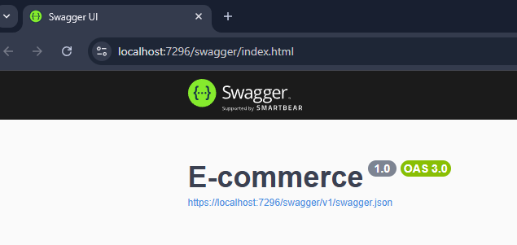

7. Environment Variables & Configuration
Setup Instructions
Clone the repository and restore as a normal .NET project
Run the project with “https” option, the project should start hosting at port 7296

Slide 18
8. Limitations & Future Improvements
Current limitations:
Limitation | Impact | Severity
Lack of Inventory Model | No stock tracking | Medium
Simple search | Only search LIKE name & description | Medium
No Authentication/Authorization | Anyone can modify products | High
Static Pricing Model | No discounts, promotions, or dynamic pricing | Medium
Limited Product Attributes | Basic name/description only | Medium
No Rate Limiting | Vulnerable to abuse | Medium
Minimal Error Handling | Generic error messages | Low
Non structured response | Hard for response handling | Medium
No logging | Difficult to debug errors | Medium
No Internationalization | Single language support only | Low
No File Storage Integration | Images stored in database (BYTEA) | Low

Slide 19
8. Limitations & Future Improvements
Future improvements
Add authentication & authorization
Inventory management system
Product attributes & extensions
Pricing & promotions
Cloud file storage
Rate limiting
Search optimization

